Slide 1
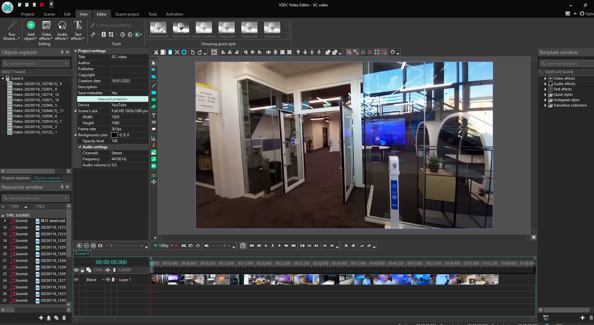
Here are my annotations on editing my video
The video advertises is here Link
I've done this editing process using these tools.
Here I have cut the footage to size and ordered it to my liking.

Slide 2
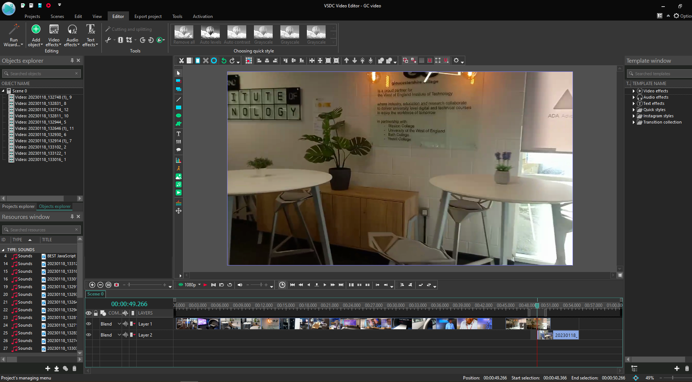
Here are my video files in my editing software which I filmed earlier of the IT department.
Here I'm adding extra footage to reach an adequate length.

Slide 3
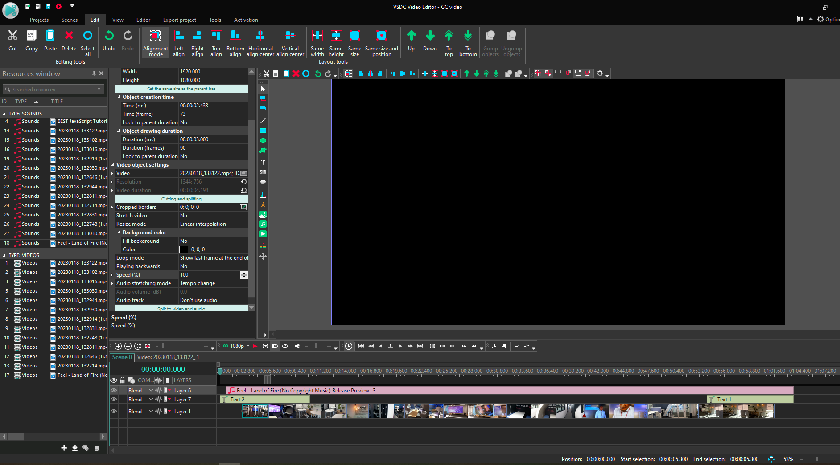
Here I've added some audio from my asset table I split the audio from the video file for this video.
Here I have added text overlays in the video at the beginning and end.

Slide 4
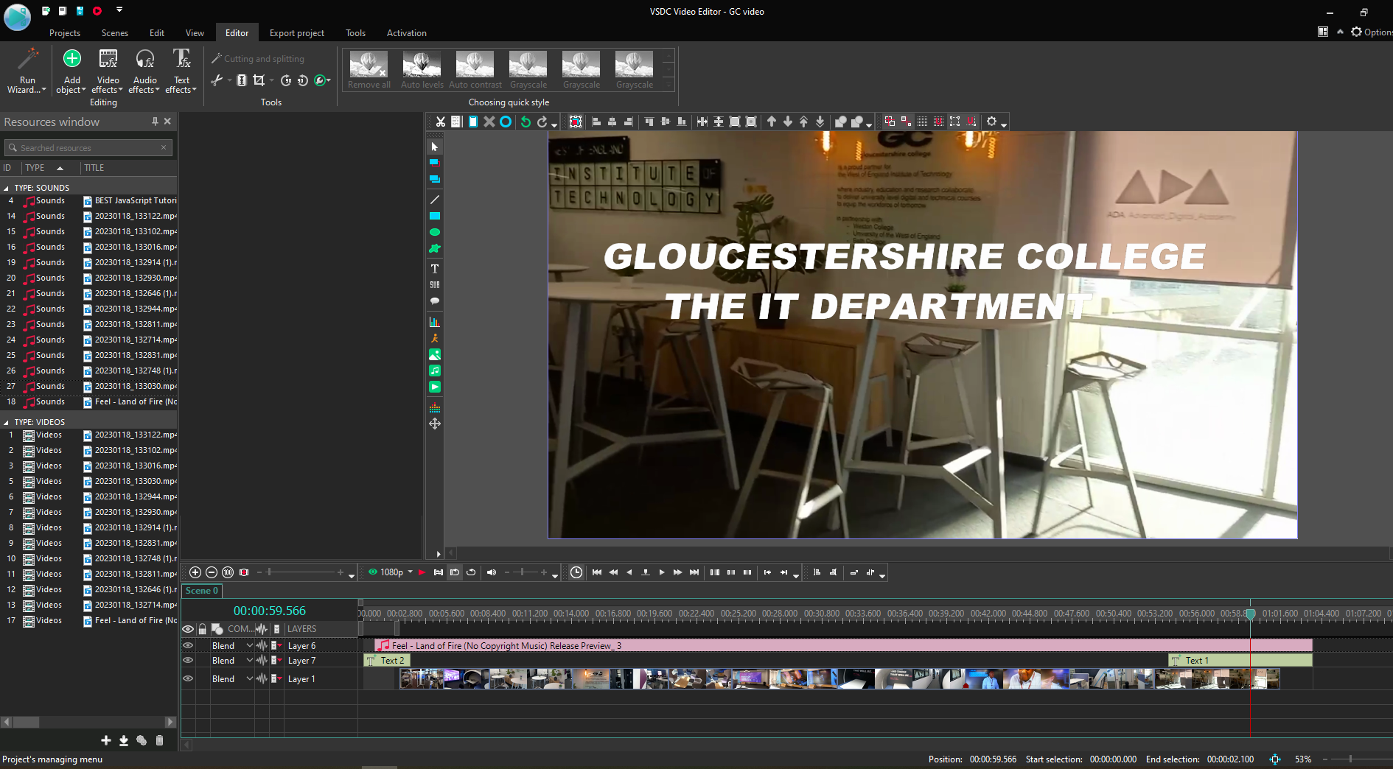
This is what the text I've inserted is saying I also added glitch effects to the video when the text is visible.

Slide 5
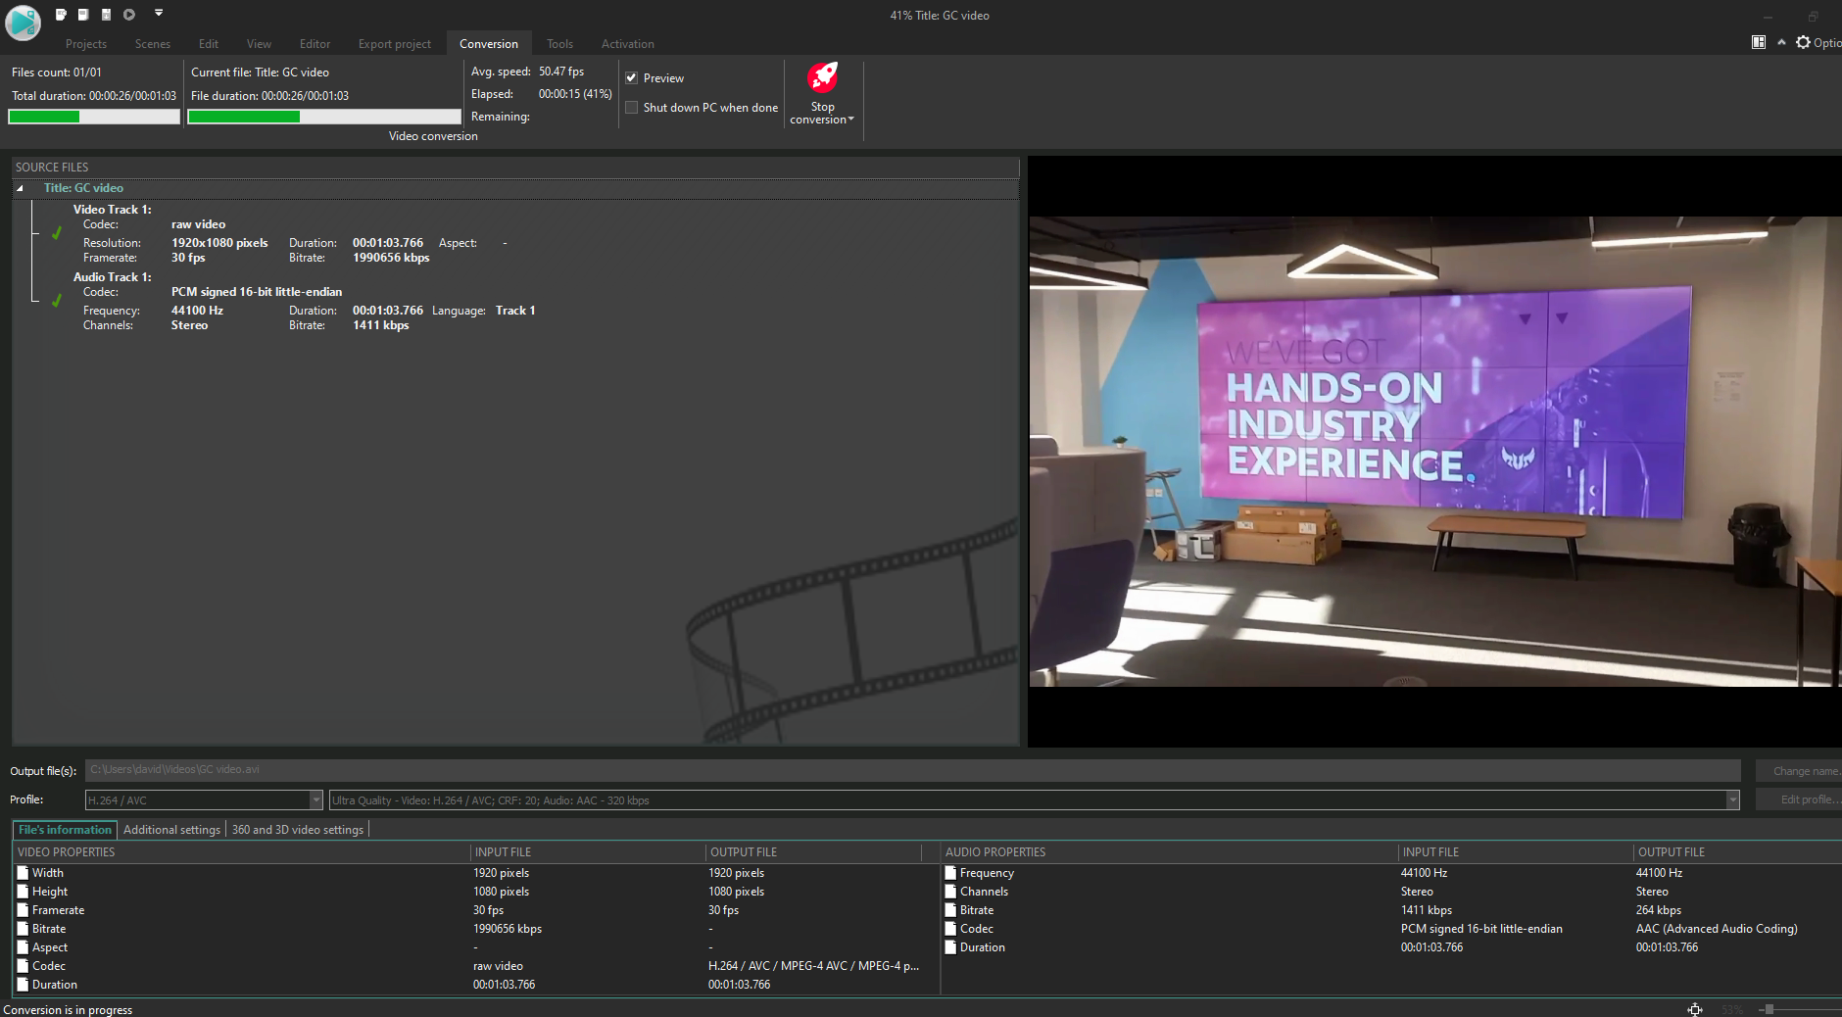
Here I am exporting the video as an MP4 file to my personal computer.
I will upload this video to the Internet later.

Slide 6
How I'm developing my video to meet the requirements I have stated in my design document
I'm adding audio and I selected the correct audio which sounds appropriate.
I have kept it simple, and I've only had text at the beginning and end which match well together when it plays in a loop.
I've made it with the glitch effect which is what was in my design document, and it works well around the text, and I have the black text which was in the design document.
My self-review and evaluation for the video
The video is good and fulfills all the things I have put in the design document.
Although I could possibly add more text to the video to display more information.
the music works perfectly, and the songs speed matches the cuts in the video which makes it nicer to watch.
This is suitable for the intended audience because it can be displayed on loop at open evenings to promote the college for parents and future students.
Constraints I had while making the promotional video
I had difficulty while making this video because some of the video that I had filmed seemed to be incompatible with my editing software and wouldn't show if I tried to play it. So, I had to refilm it with a worse quality camera.

Slide 7
Here are my two peer reviews for the video.
1 Beverley Haagensen: The Gloucestershire College IT department video gave a good glimpse into the facilities and work of the department. My only suggestion would be to cut the "the" in the title so it just say Gloucestershire College IT department. The music was very appropriate.
2 Peter Haagensen: I liked way the music built up over the video and thought the filming was good. More people would add interest if it was allowable. It was good to see inside the department.
description of potential changes the feedback suggests
I should change or next time I would make the text clearer and maybe get permission to of people round do you make it more inviting.

Slide 8
My test plans for the video
Test number | Item to test | Expected outcome | Actual outcome
1 Video | If the video can be played in loop | it should be capable of being displayed in loop. | The video could be played in loop.
2 Video | Is the content appropriate for parents and students | It should be appropriate for all ages. | The video was appropriate for all ages.
3 Video | Does it advertise and promote the IT department | It should advertise and promote the ID department. | It promotes the IT department visually.

Slide 9
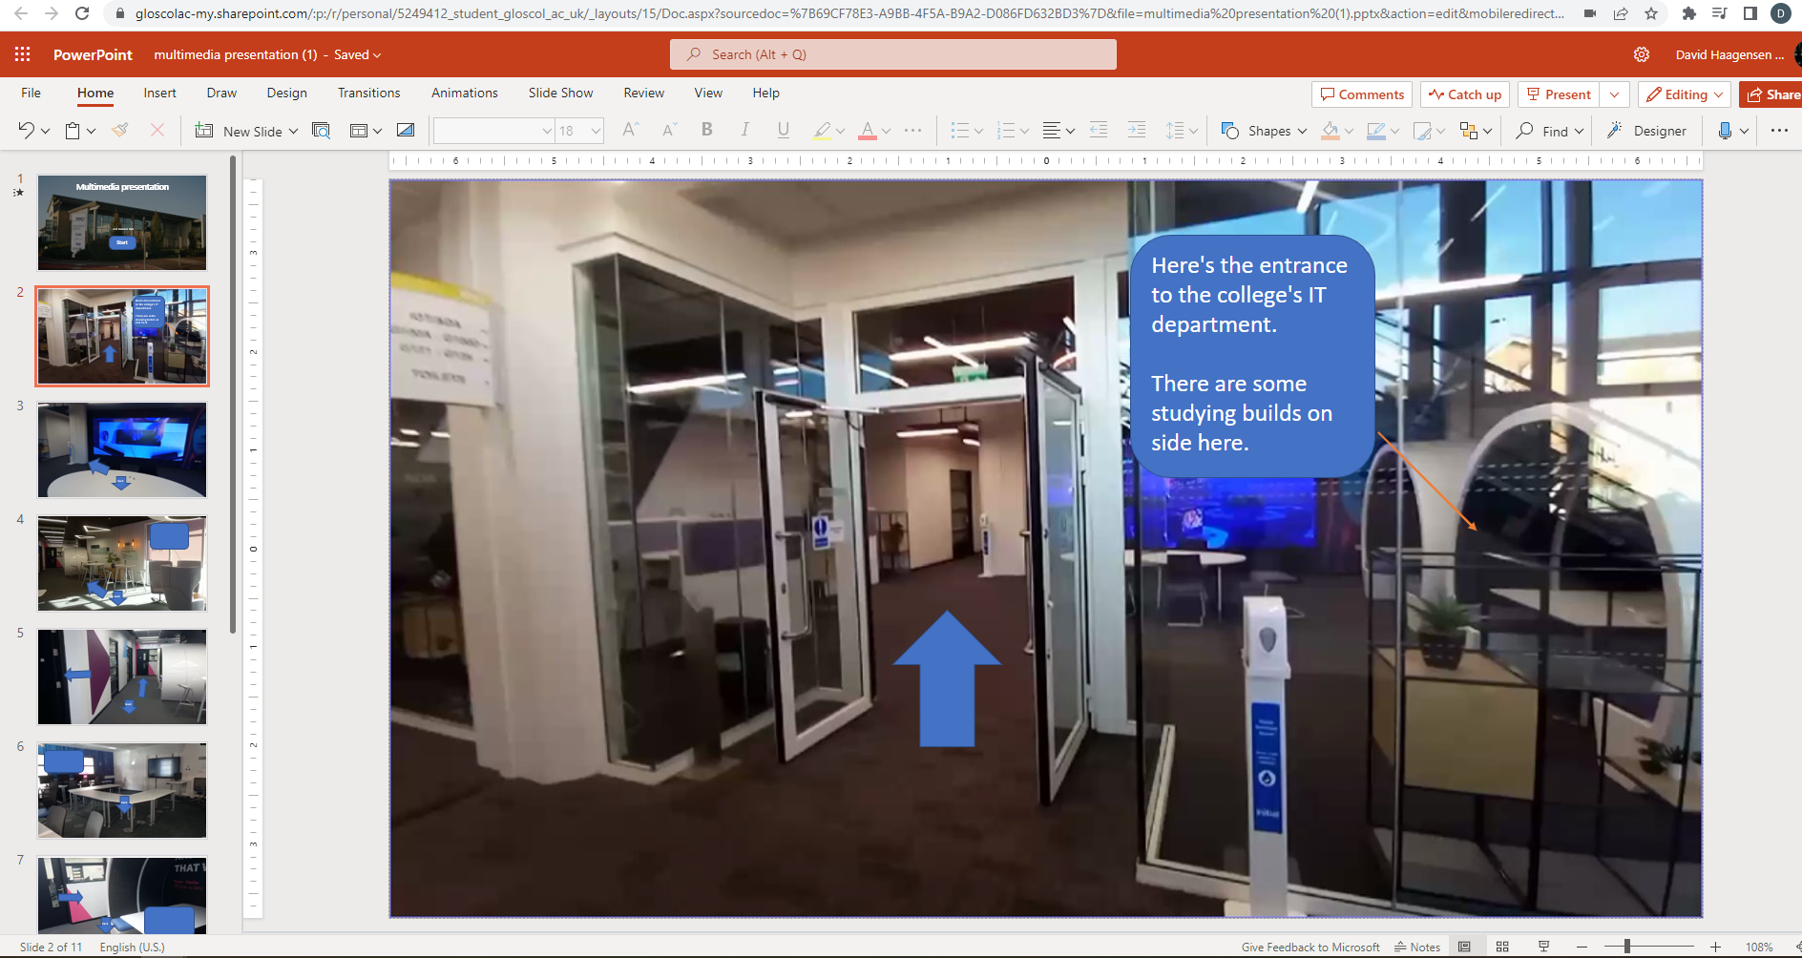
My creation of the interactive PowerPoint.
The interactive PowerPoint is on the VLE
Here on the right are all mine images with keys too other pages.
Here I have added an arrow which I have hyperlinked to the next page.

Slide 10
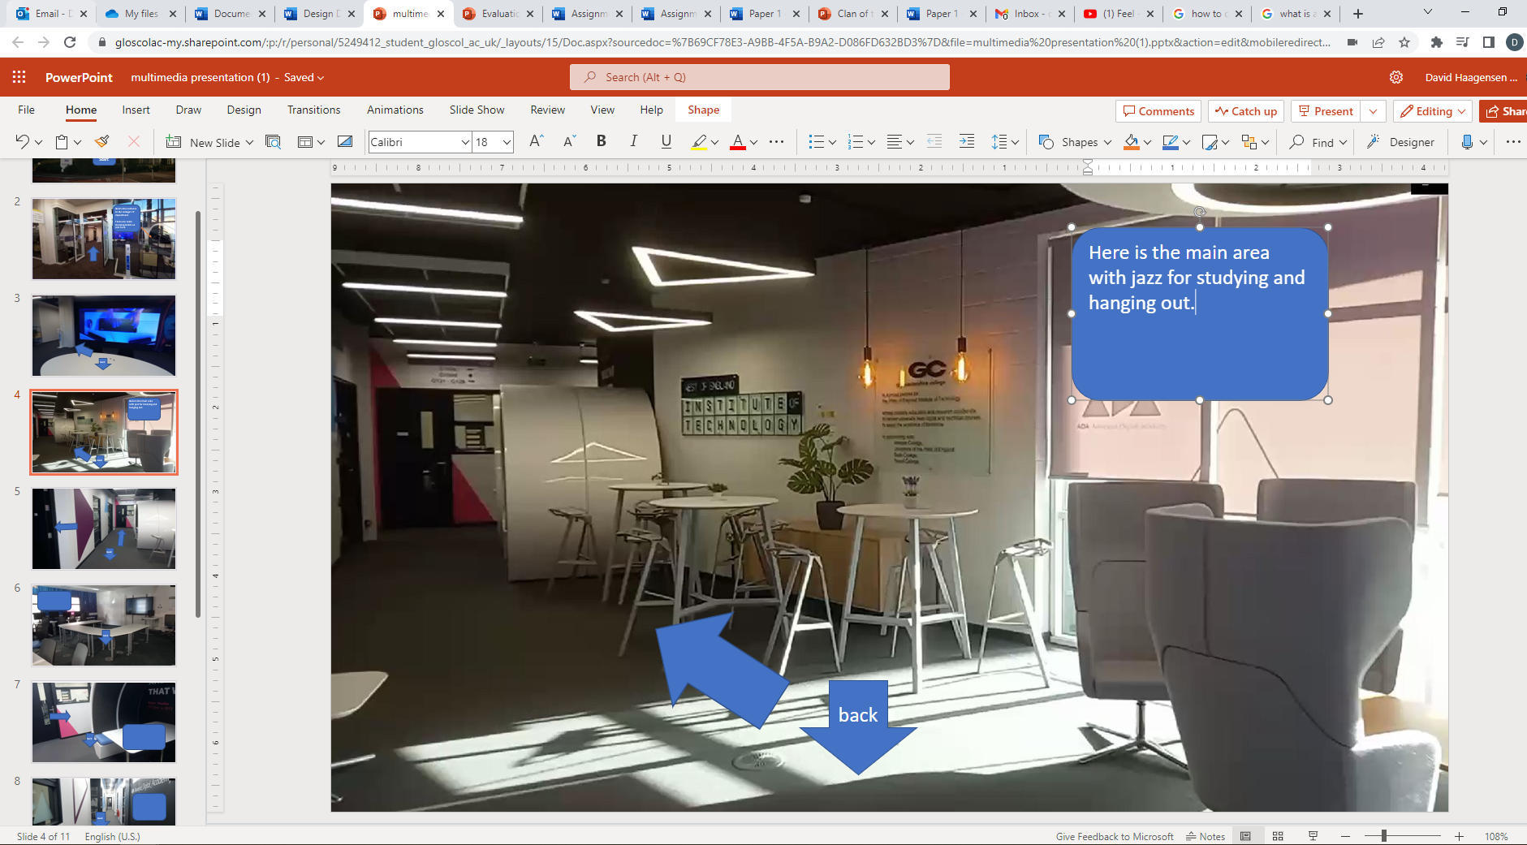
Here I am writing the text about this room in the IT department.

Slide 11
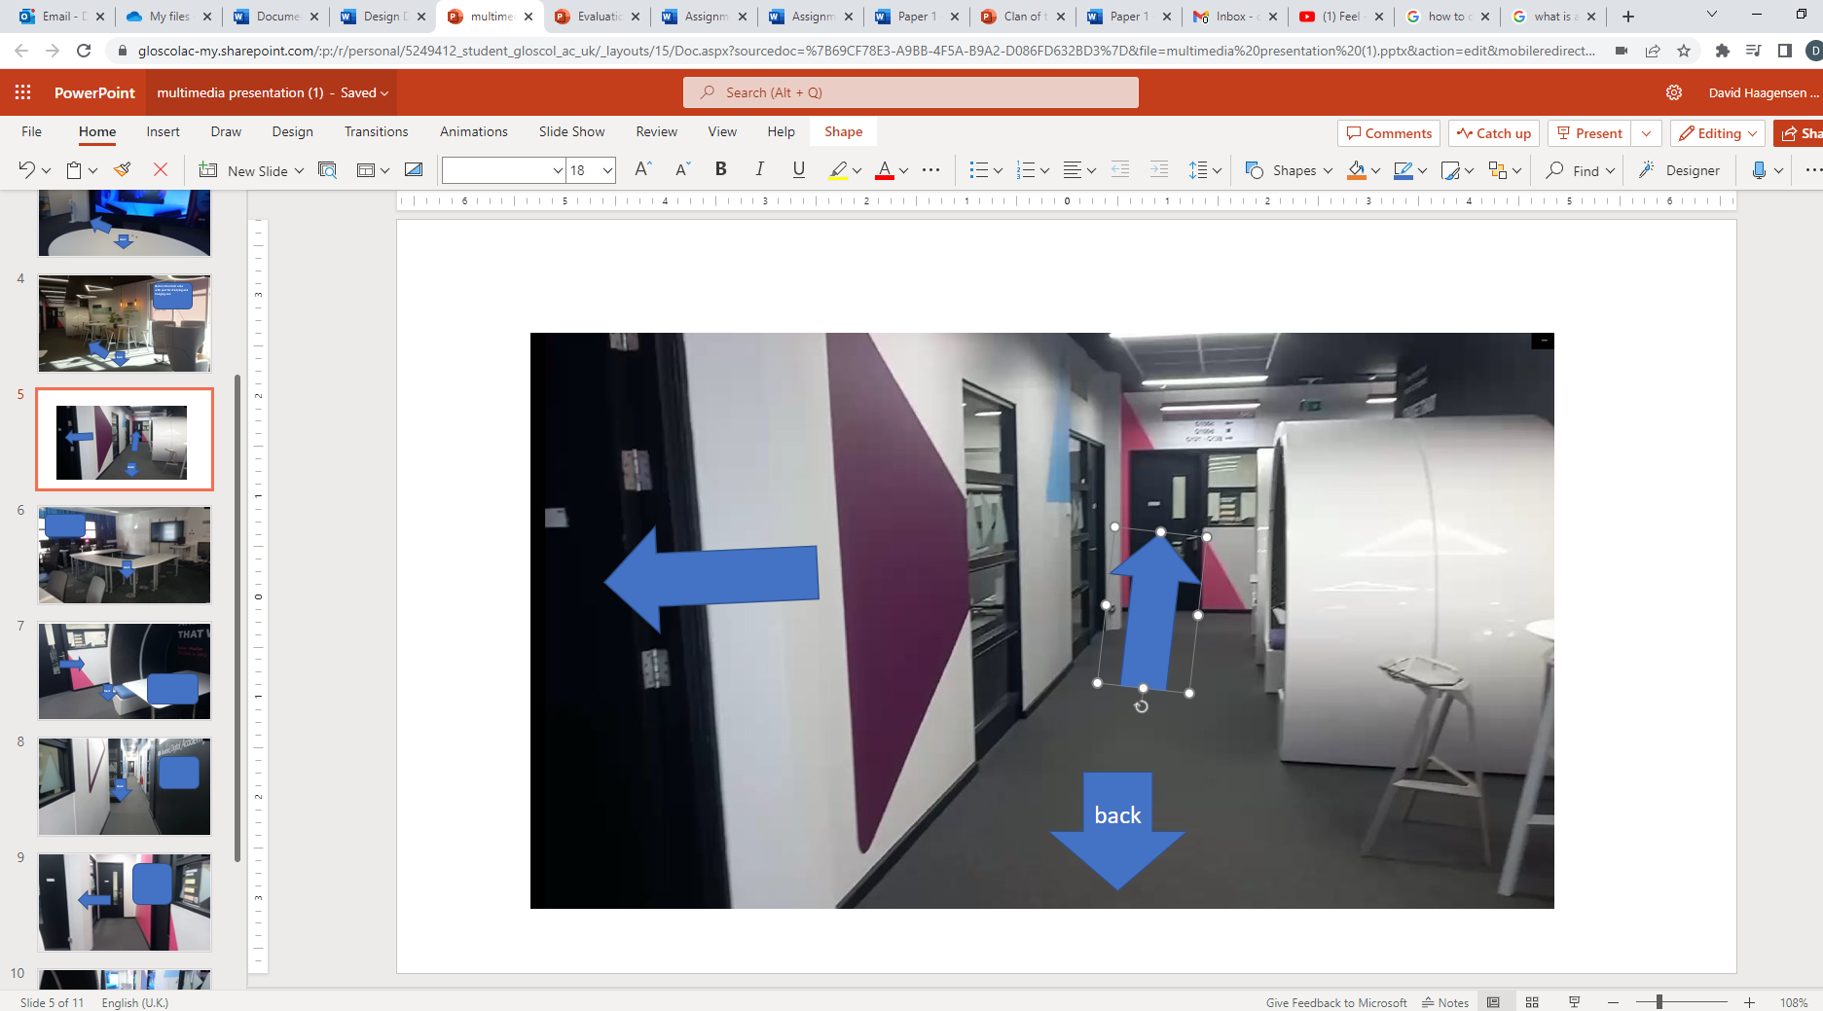
Here I am still positioning the interactive keys and image for my PowerPoint presentation.

Slide 12
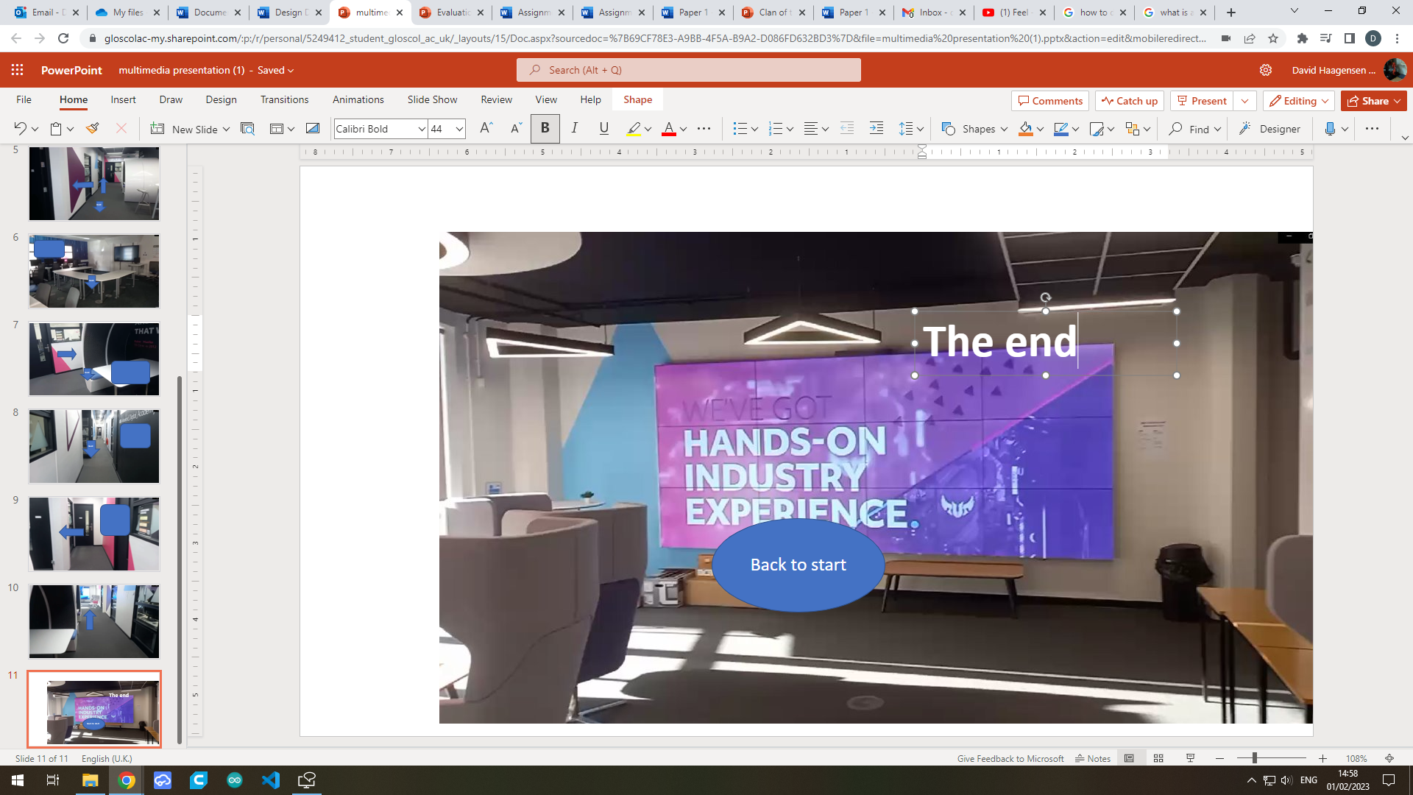
Hey I'm writing the text at the end of my interactive PowerPoint.
Hey I have a button to go back to the start to review.

Slide 13
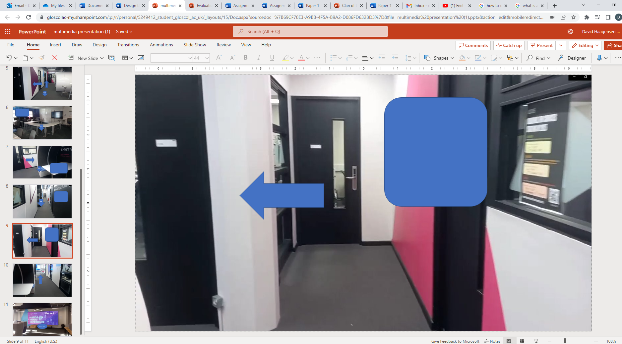
Here I have inserted a text box which still needs its text added to it.

Slide 14
How I am developing the presentation to fulfill the requirements in the design document
I have made this to fulfill my requirements by being easy to navigate and I have added textboxes talking about The IT department and it navigates through the IT department using the blue buttons that I said I would use in my design document.
My self-review and evaluation for the interactive PowerPoint
The functionality works perfectly, and it fulfills what I put in the design document.
Although I could talk more about The IT department and make it clearer.
This fulfills the user requirements and purpose by being easy to navigate and informing the viewer about the IT department.
Constraints I had while making the interactive PowerPoint
OneDrive PowerPoint doesn't seem to be able to create hyperlinks meaning I wasn't able to produce the interactive keys, so I had to use the downloaded software to make the interactive PowerPoint.

Slide 15
Here are my two peer reviews for the interactive PowerPoint.
1Beverley Haagensen: Thank you for this multimedia presentation, which gave a good idea of the layout of the IT department. I found the arrows easy to use although maybe an instruction to click on the arrows to progress would be helpful.
I have a few small suggestions regarding the captions and I will number them for the appropriate slides.
Slide 2: The second sentence was a bit clumsy. Maybe it should read: On the right are some study booths.
Slide 3: I would have appreciated a caption here.
Slide 4: With jazz? You mean music or is this a typo?
Slide 6: The wording could be improved. Maybe: Here is an IT classroom. It has comfortable chairs, a high-resolution monitor at the front and good quality computers for the students.
Slide 7: ?Comfortable study or eating booths?
Slide 8: This is hard to understand. Maybe: In front is the IT office, to the right another classroom and to the left the main area with seats.
2Grace Haagensen: I thought this was a great introduction to the IT department at Gloucestershire College. Well structured and easy navigation. Some of the captions could be worded better to make them clear. Otherwise, a good overview of facilities in department.
description of potential changes the feedback suggests
These reviews suggest that I need to make me text in the text boxes clearer and make them relate to the IT department more.
that should be also suggests that I should give some instructions at the beginning on how to navigate.

Slide 16
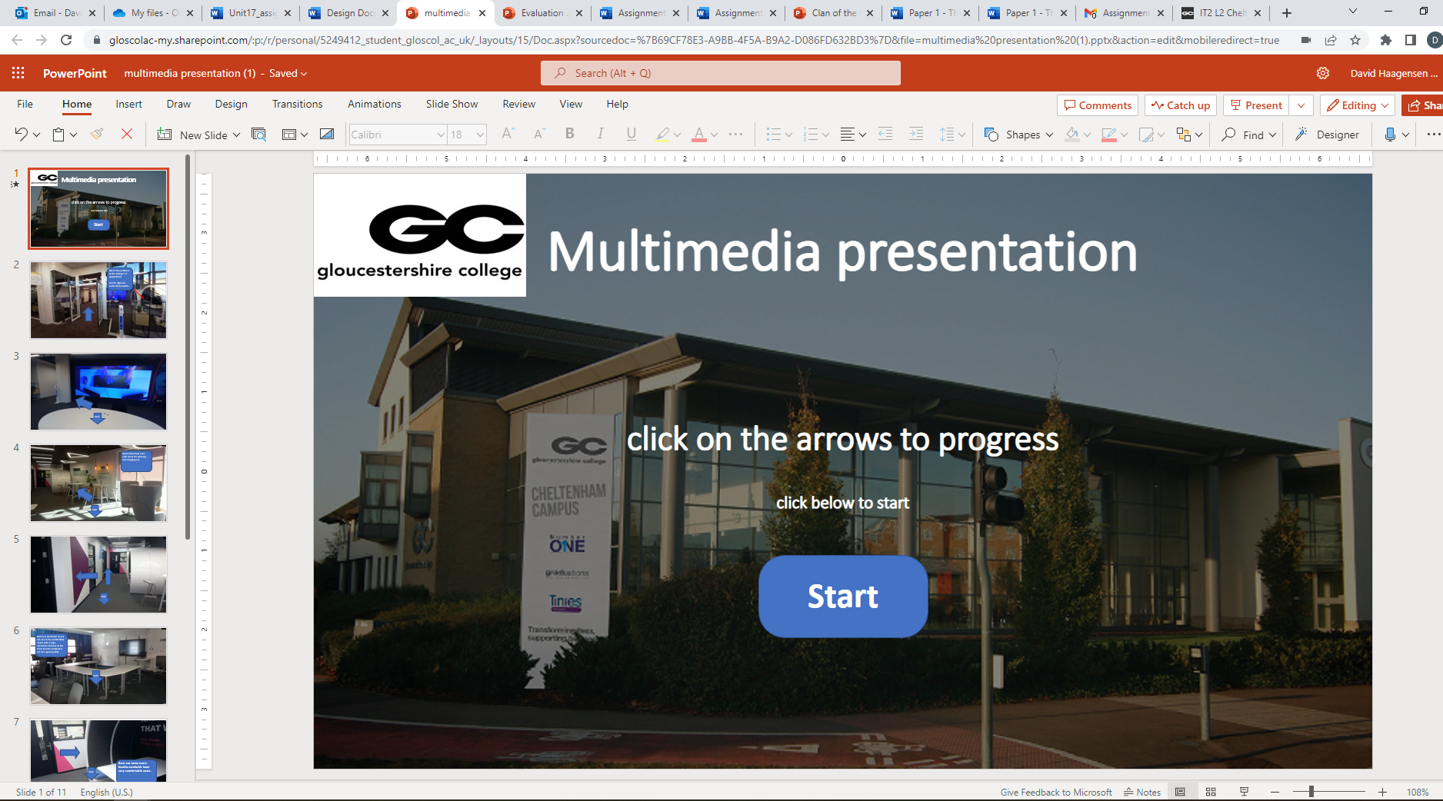
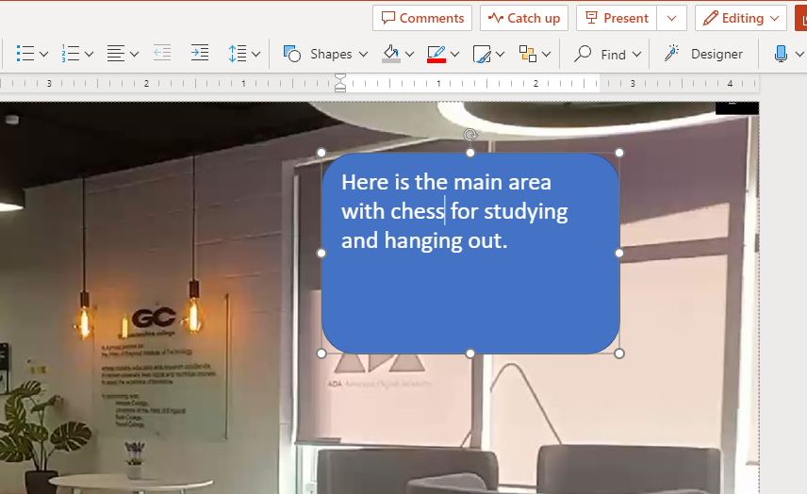
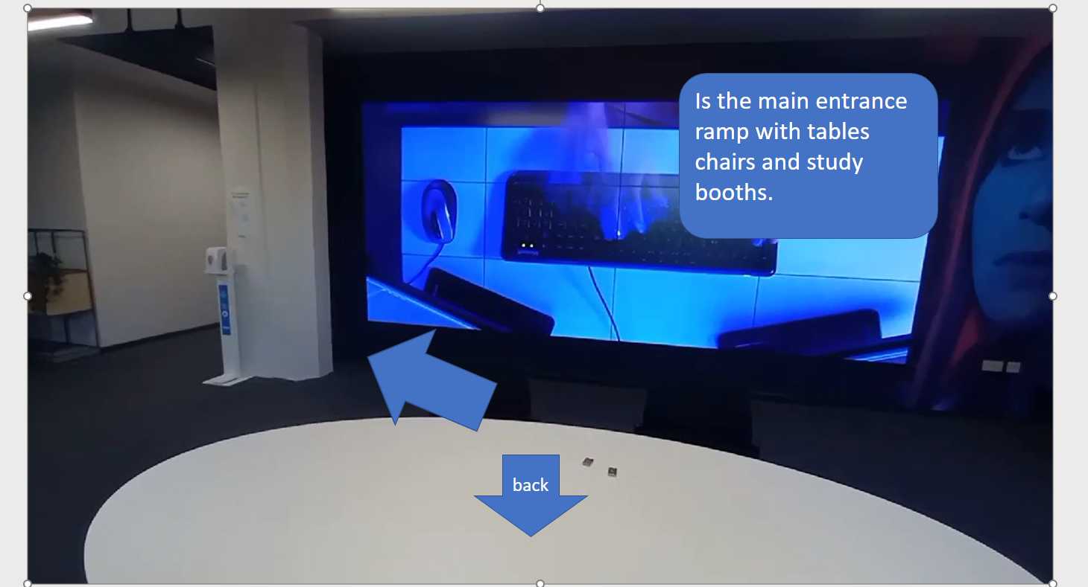
here I have corrected some spelling errors that I gathered from the feedback.
Here I am adding a click on the arrows to progress the first page has adapted from the feedback so the user knows how to navigate the PowerPoint presentation.
Here I've added a textbox because the feedback seemed to suggest that one was needed on this slide.

Slide 17
My completed test plan
Test number | Item to test | Expected outcome | Actual outcome
1 PowerPoint | Do the navigation keys work and is it easy to navigate. | They should or function correctly and be easy to use. | The navigation keys worked perfectly.
2 PowerPoint | Does it adequately inform the viewer the features of the IT department. | I would expect it to display most if not all the information required for the viewer. | It does although it could improved.
3 PowerPoint | Is content appropriate for parents and students. | This content should not be inappropriate in anyway | The content is appropriate for all ages.

